Slide 1
Introduction to Motivated Minds
www.motivated-minds.co.uk
01268 520785

Slide 2
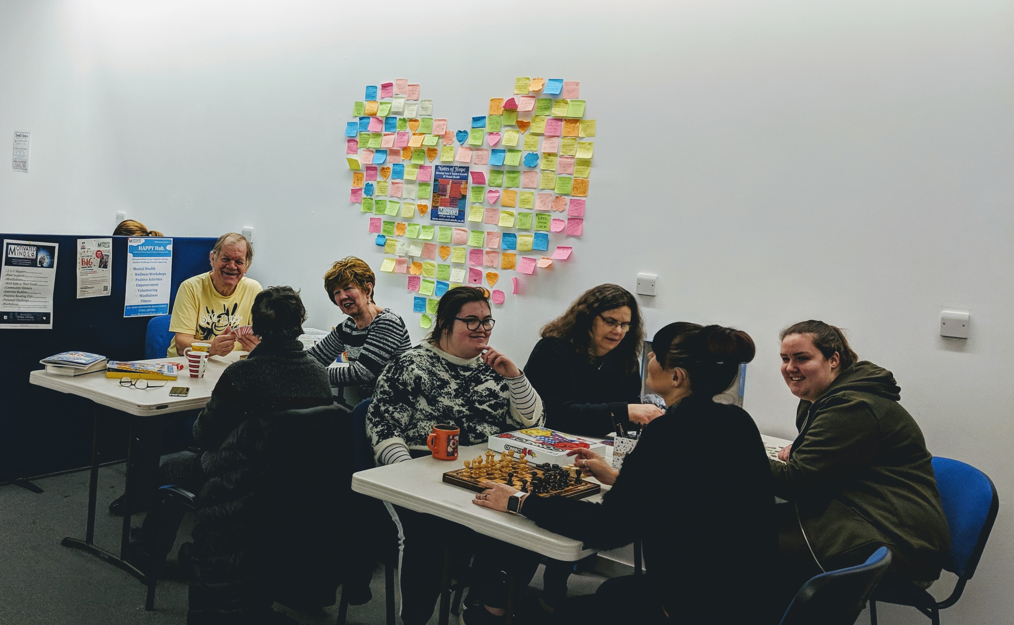
Who Are Motivated Minds?
Conceptualised by Carla in 2011 - Officially formed in 2015
Crisis Point to realisation of potential
Non-for-profit Community Interest Company – ethical business
Based in Basildon Borough
Delivering Life-long wellbeing:
In the Community
Employment Support
Workplace Wellbeing
Schools / Colleges / Youth Services
“Feeling on the brink of self-destruction and knowing MM was only a phone call away”.

Slide 3
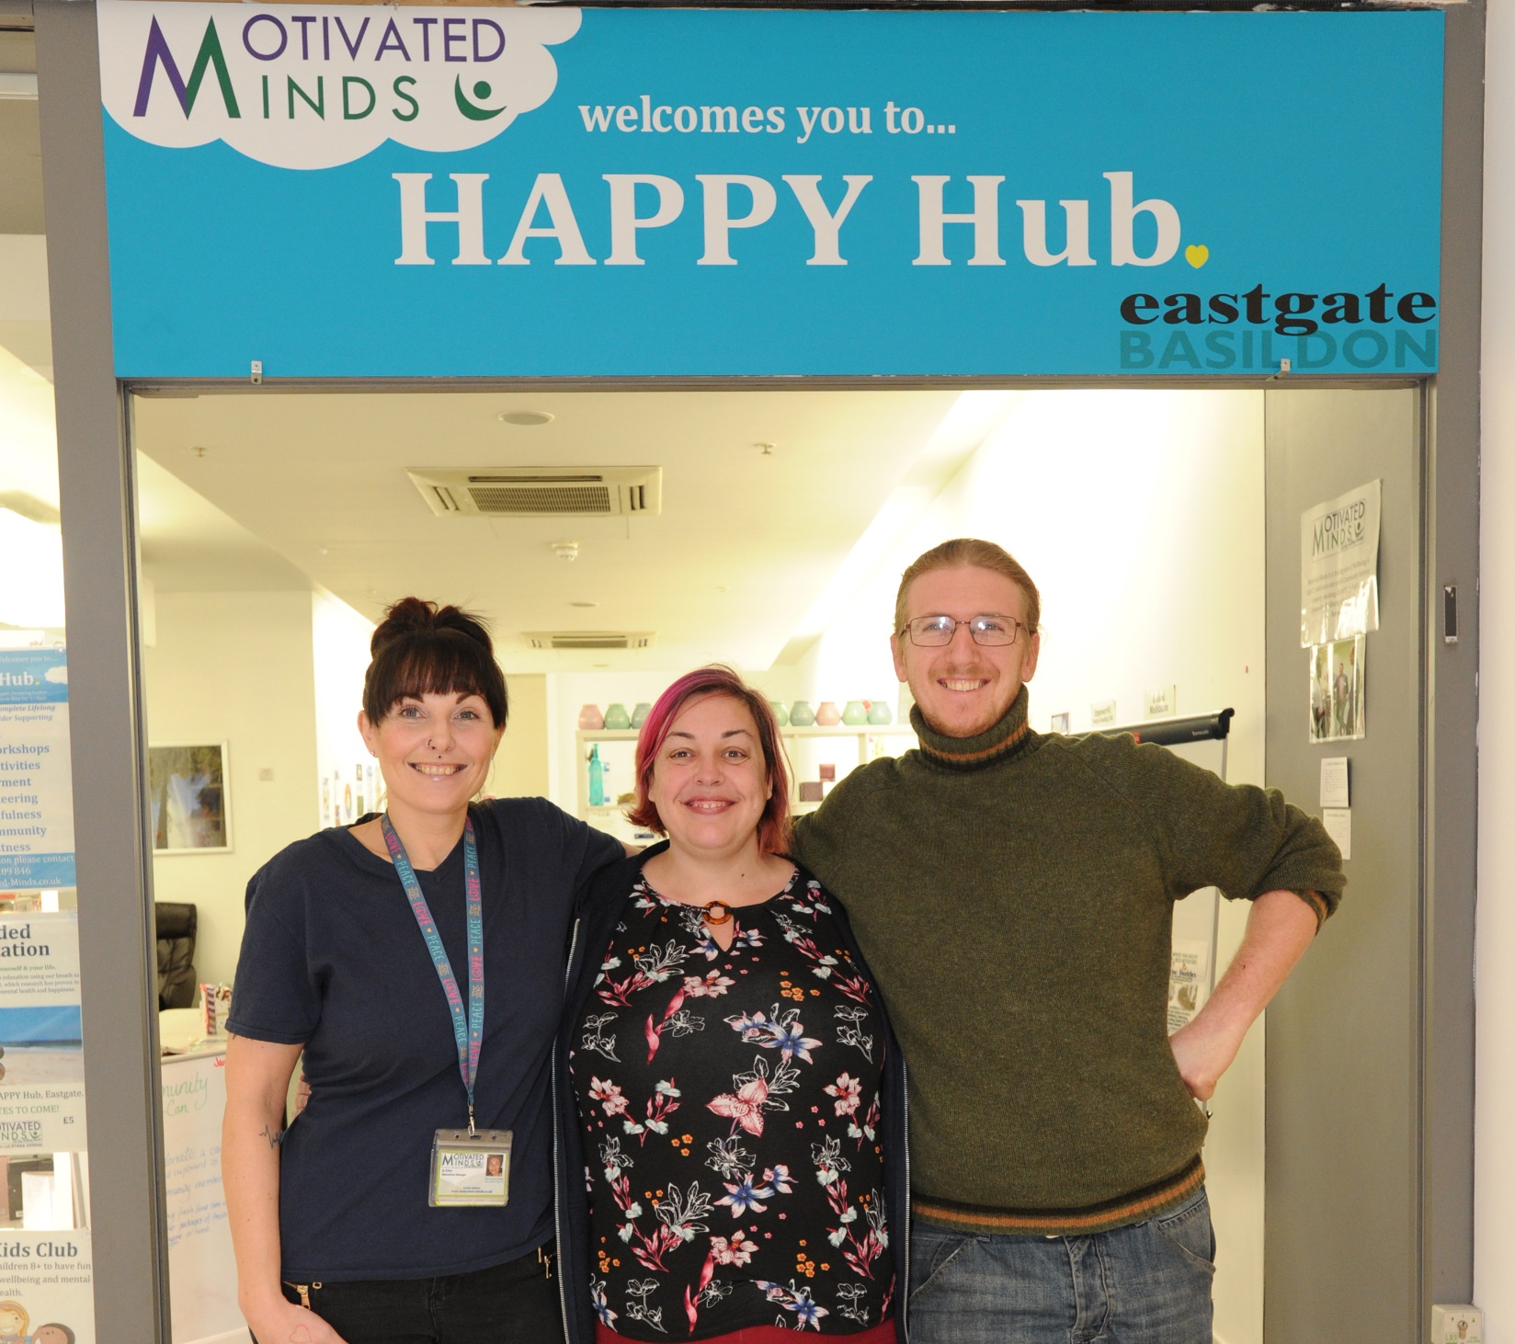
The People Behind Motivated Minds
Founder & Managing Director – Carla Andrews
2 Additional Directors
2 Part-time employed team members
Coach Core Apprentice
Horticultural Lead
20 Volunteers
3 full-time, 15 part-time & 2 ad hoc
“My mind was in the darkest place and MM gave light at the end of the tunnel”

Slide 4
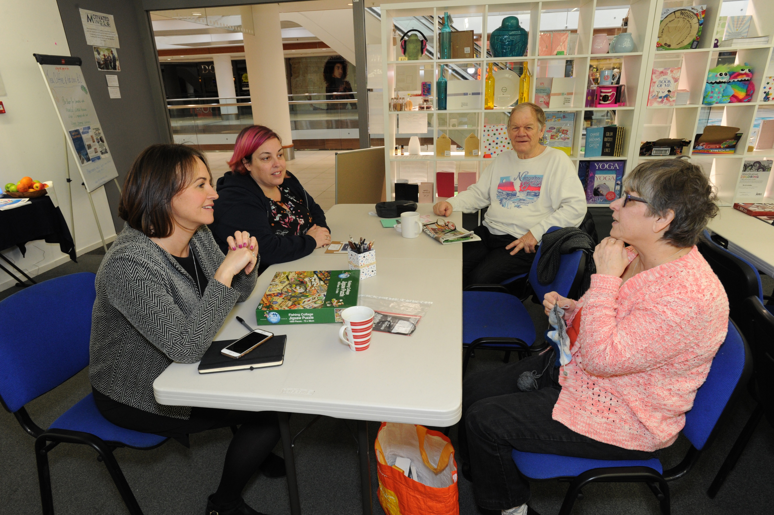
Why
To help people realise and reach their full potential, regardless of past and present circumstances.
Life-long to maximise consistent support service through transitional stages, as well as being able to work with families
Focus on early intervention & building psychological life skills
Ongoing service
Pay-it-forward ethos. Social Action
“Bridging the GAP is brilliant. Every morning I woke up with a positive attitude about it. I loved that I could meet new people”.

Slide 5
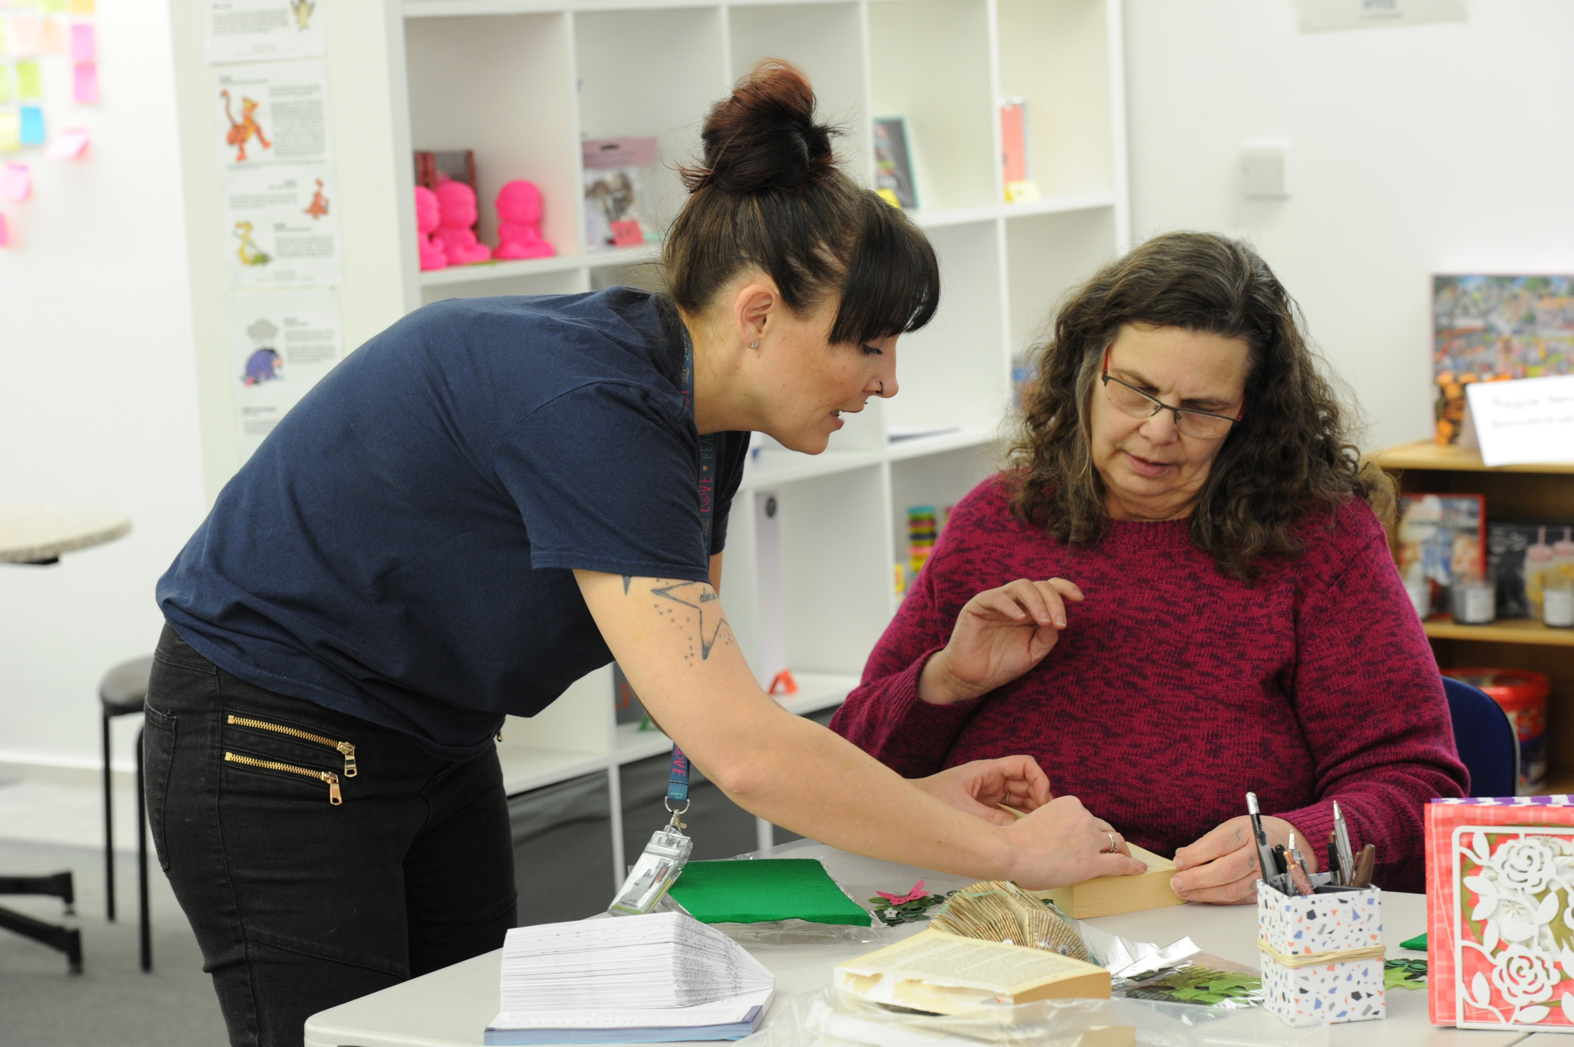
How
Experience
Life – Realistic Role Models
Work – supporting individuals to overcome barriers
Client Empowerment
Client needs – supporting clients to identify their barriers
Client barriers – supporting clients to map positive interventions
Variety of support – Counselling, Mentoring and Coaching
Flexibility of service realistic to 2018 -
Methodology
Applied Positive Psychology
Coaching
“The team really helped me grow in confidence, for that I will be ever grateful”
- Foundation 4 Future Employment Attendee

Slide 6
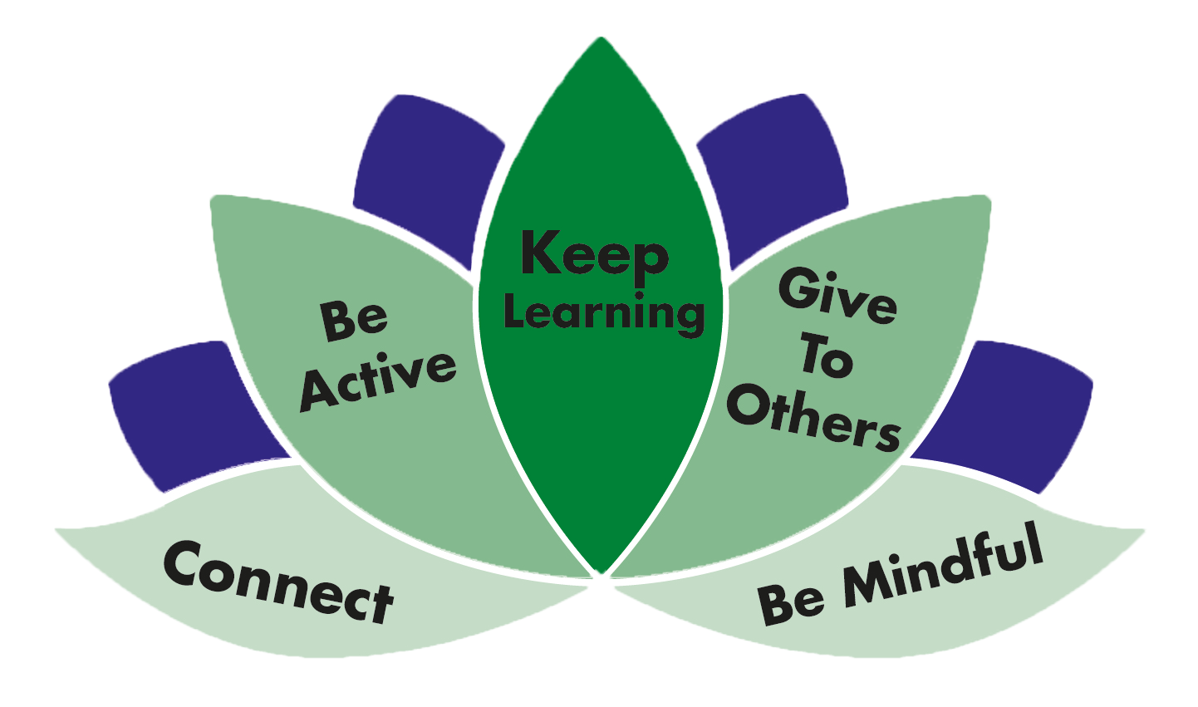
What
5 Ways to Wellbeing
Connect – peer support
Learn – Empowerment
Physical Activity – Exercise Buddies, Walk 4 Wellbeing, Personal Challenges
Give – Purposeful volunteering – Meaning & Purpose
Mindfulness – Workshops, Meditation & Walks
Community Wellbeing Hubs
Workshops
Positive Activities
Kids & Youth Clubs
Social Media

Slide 7
Client Journey
Listening
= Resilience

Slide 8
Partnerships

Slide 9
Quality Assurance
CVS
Active Essex
Essex Youth Service
Basildon Council
Notes:
Over achiegve on targets

Slide 10
Income
Sale of services
Sale of merchandise (online/events/hubs)
Grants
Essex Lottery
Donations
Amazon Wish-list

Slide 12
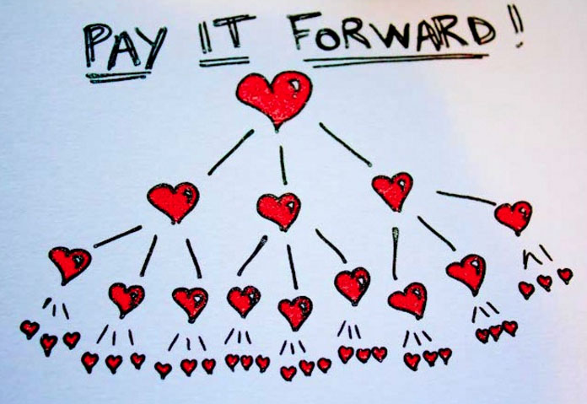
Vision
Sustainable business that reinvests back into localised wellbeing
Create easily assessable, inclusive service
Driven and propelled by clients
Up-skill clients to employment ready
Innovative approach to wellbeing

Slide 13
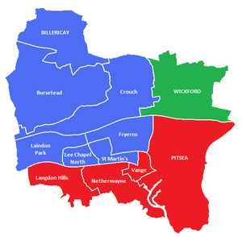
Basildon Borough Wellbeing 2021
Tackle root cause
Building community to establish asset friendly approach
Bridging the gap between services
Build on local knowledge
Strong preventative resources established
Reduction on NHS resources
Reduce offending and reoffending
Build community cohesion & identity

Slide 14
Why Motivated Minds are Best Placed to Deliver
Highly skilled team
Reach into the community
Local knowledge
Excellent relationships and trusted partner
Over deliver on projects
Professional and holistic relationship
Feed into a whole system approach
Asset Based Community Development

Slide 15
Any Questions

